Slide 1
Macular Holes
Nigel Kirkpatrick
SWONS
May 2011

Slide 2
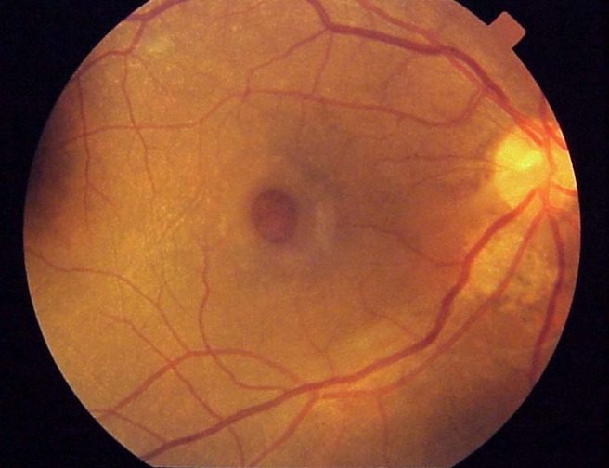
Macular hole

Slide 3
History
1st reports in 1869 – Knapp (trauma)
  Related to myopia, inflammation, trauma
!970’s and 80’s – most idiopathic
1990’s – reports of surgical treatment

Slide 4
Incidence & Causes
1 in 3300 of population
  ?overestimation
Peak incidence in 50’s and 60’s
  Female >>male
Idiopathic hole
  Contraction of vitreous in macular area
  Tangential forces causing separation in macula
  Pseudo-operculum of glial tissue forms
  Photoreceptors remain in retinal layer

Slide 5
Gass Classification
Staged according to appearance

Slide 6
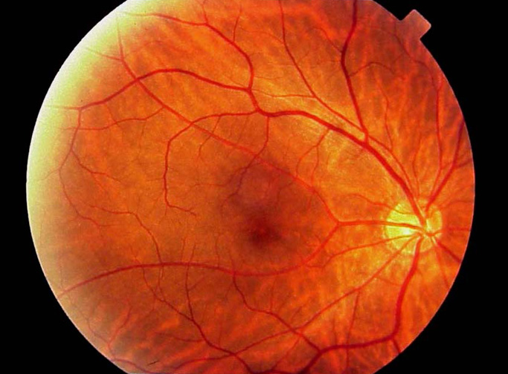
Stage 1
Yellow Dot, good vision, no distortion

Slide 7
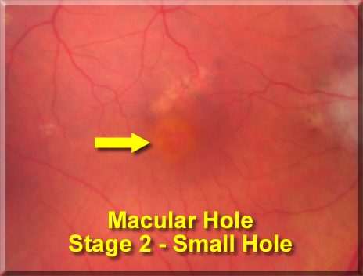
Stage 2
Tiny slit / hole, good vision (6/12), sl distortion

Slide 8
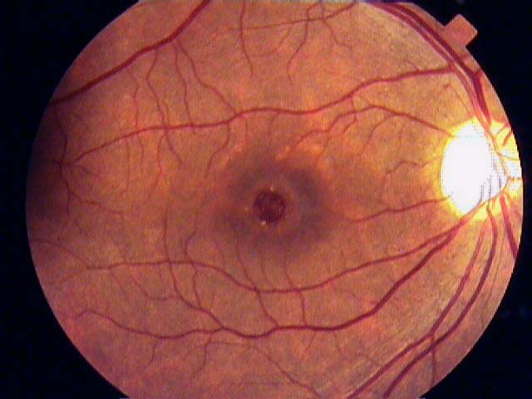
Stage 3 (st 4 same with pvd)
Obvious hole, vision 6/24, distortion ++

Slide 9
Symptoms
Vision – variable
Distortion (metamorphopsia)
Occasionally none (early holes etc)

Slide 10

Signs
Watzke Allen test

Slide 11
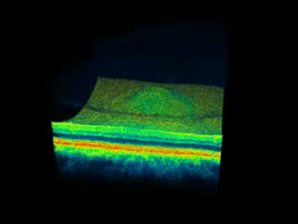
Investigation = OCT

Slide 12
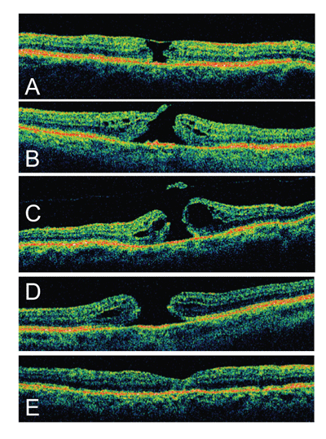
OCT staging
A = St 1
B= St 2
C= St 3
D=St 4
E= Post op

Slide 13
Treatment
Surgery option vs. conservative
  Dominant vs. non- dominant eye
  More right eyes
Vitrectomy
  Consent
  Risk vs. benefit

Slide 14
Kelly and Wendel 1991
Vitreous Surgery for Idiopathic Macular Holes
Results of a Pilot Study
Neil E. Kelly, MD, Robert T. Wendel, MD
Arch Ophthalmol 1991 109 654
One of the most quoted VR papers
No treatment until this time
Gass classification
Observed that PVD protected against macular hole
60% success rate with vitrectomy and gas

Slide 15
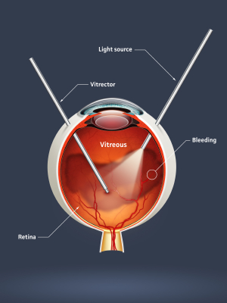
1990’s
Everyone tried it
Variable success
Late 90’s
  Bizarre posturing regimes
  Platelets
  Forceps from Moscow

Slide 16
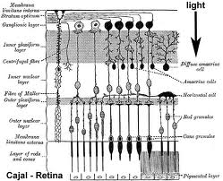
Modifications 2000 - 2010
ILM peel
  Not for faint hearted!! – almost invisible
  Increased hole closure to >90%

Slide 17
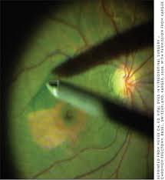
Dyes
ICG – excellent view
Safety record in doubt

Slide 18

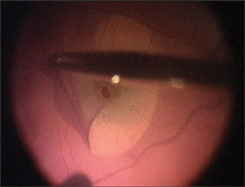
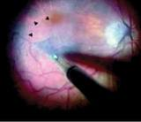
Dyes 2
Trypan blue
  Membrane blue – good for erm not ilm
  Brilliant peel

Slide 19
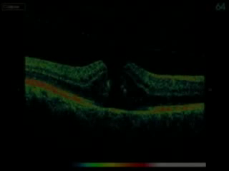
Surgery – vity, pvd, peel, gas

Slide 20
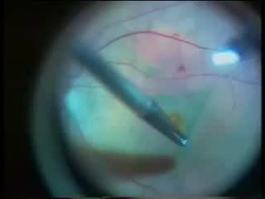
Surgery – ILM peel

Slide 21
Results
Depends on hole stage / size
  Stage 2-3 = >95% closure
  Vision improved by 2 lines in >80%
  Amount of vision improvement can be predicted by OCT
  Larger holes (>400 microns) harder to close
  Stage 4 holes 70-80% closure

Slide 22
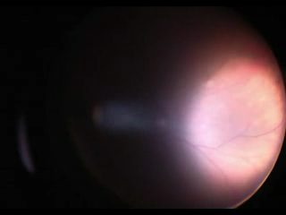
Complications
Macular damage
Iatrogenic tear
Cataract – almost every case
Field defect

Slide 23
Controversy
Phaco at same time
Posturing
Value of ILM peel

Slide 24
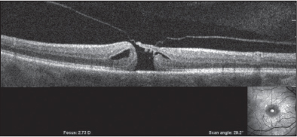
The future

Slide 25
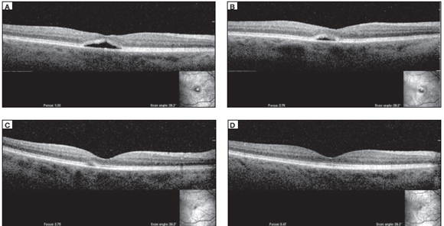
Microplasmin

Slide 26
Summary
Zero to hero in 1 generation
Injection era is upon us
Value of OCT in macular disease
Any questions

Slide 27
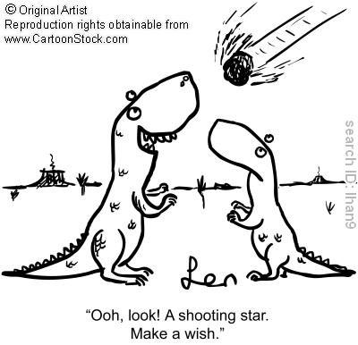
The dinosaur

